Slide 1
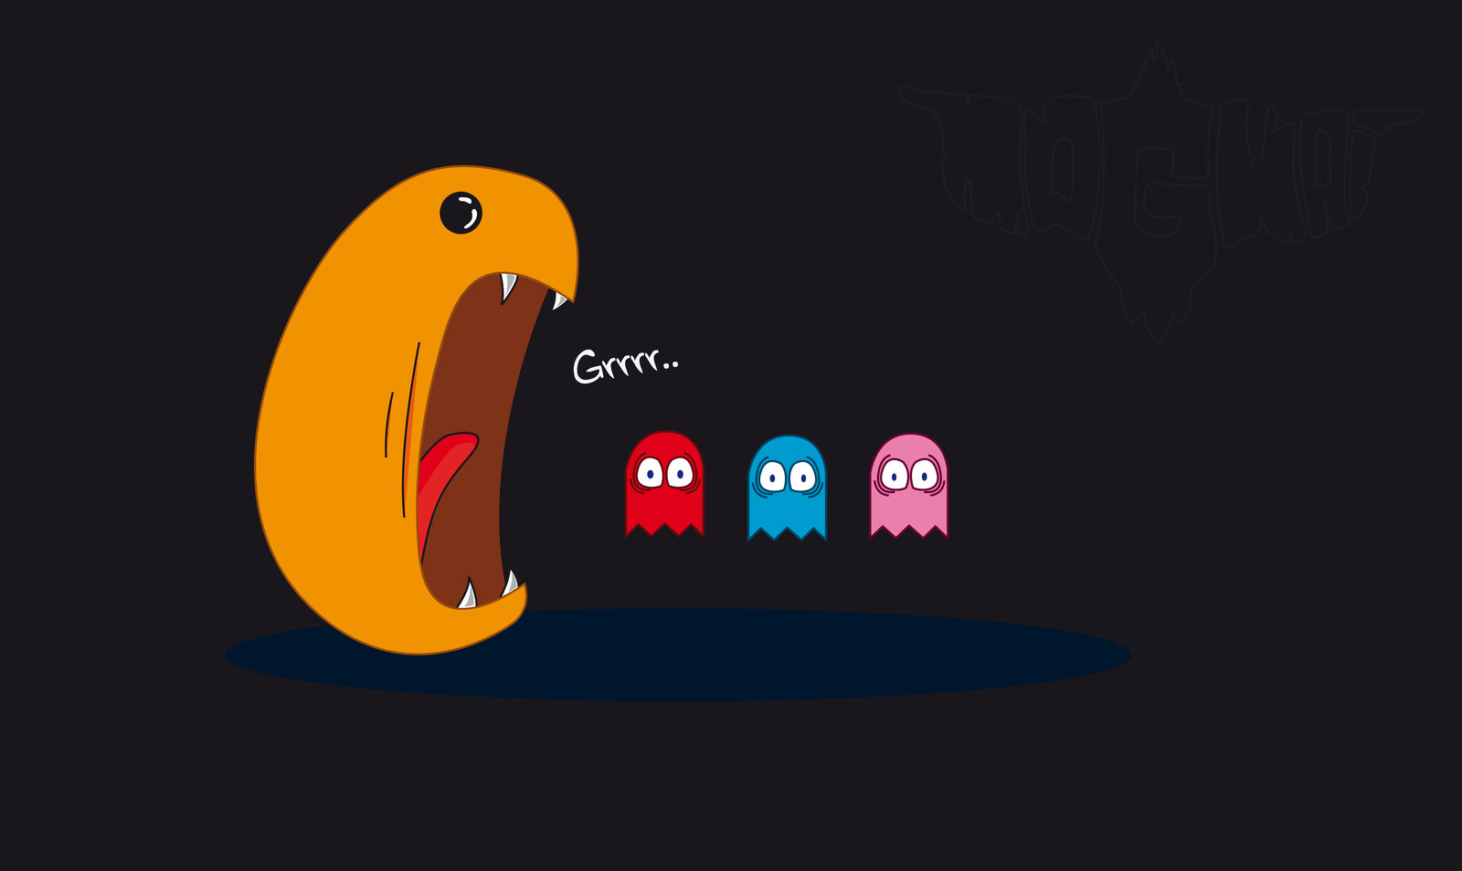
HELP!!!
Five nights at PAC - MAN
Scfled Productions
Henry reYES AND QUISHA mUTYA

Slide 2
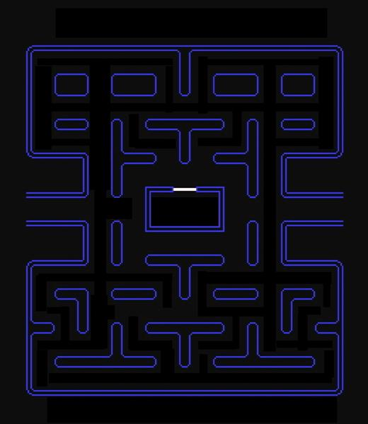
5:00am
health:37
Energy: 50
These are power pellets that gives you energy/ fuel so your screen does not get foggy
These are the white dots; the player collects them to gain health.

Slide 3
When you have no energy the screen will be foggy.
These are your enemies who will be walking around if you get touched by them you’ll DIE.
And a jumpscare!

